Slide 1
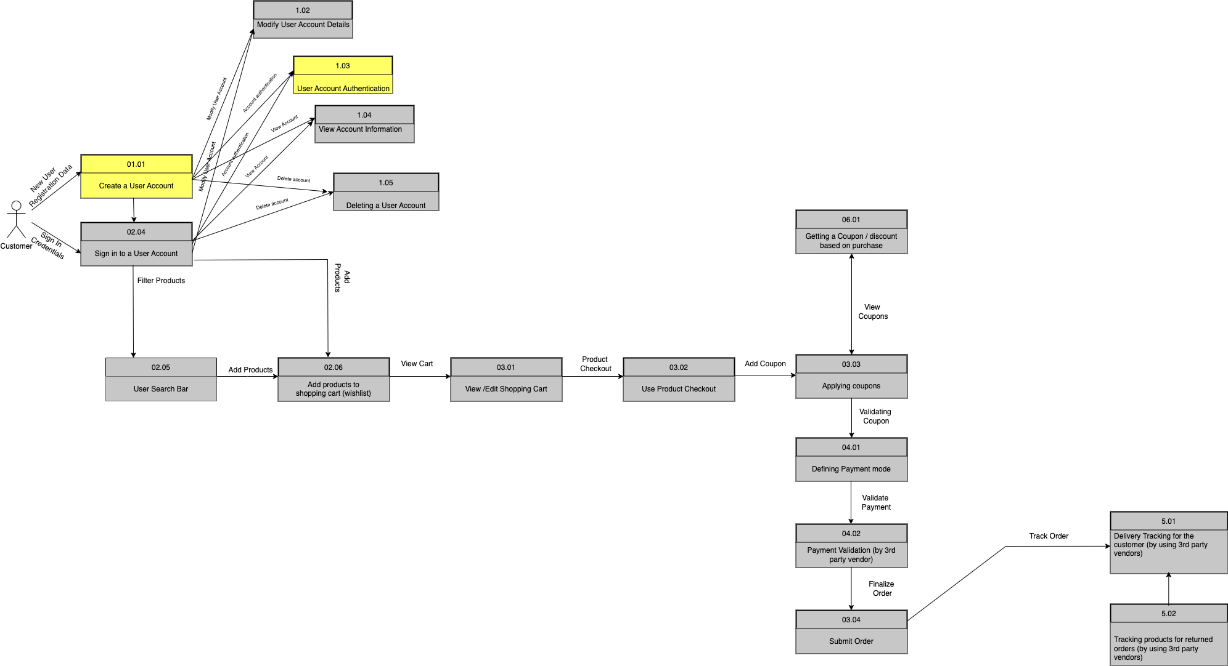
Flaunt
Data Flow Diagram(Logical)

Slide 2
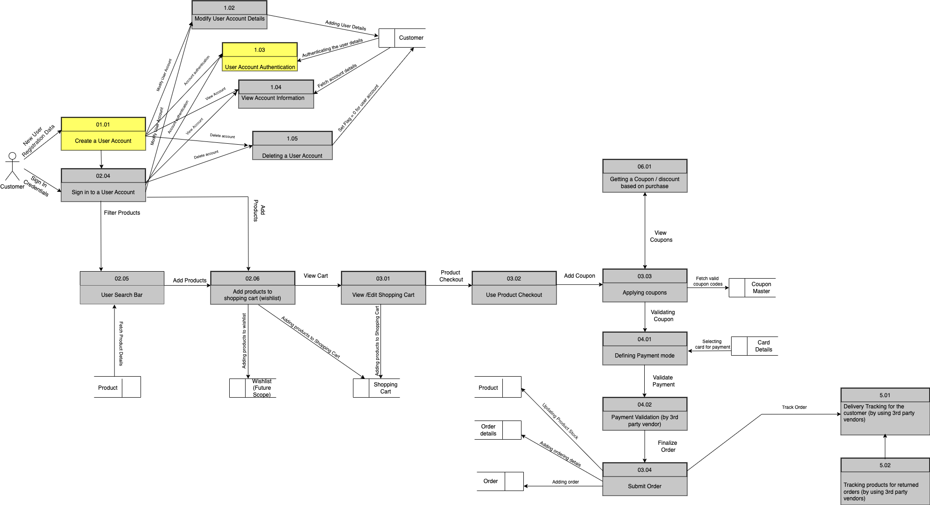
Flaunt
Data Flow Diagram(Physical)

